Slide 1


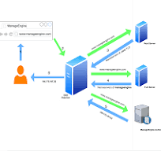
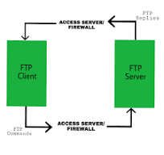
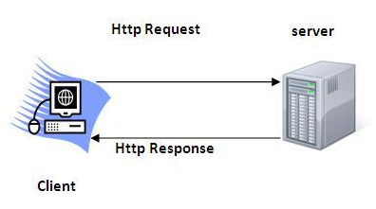
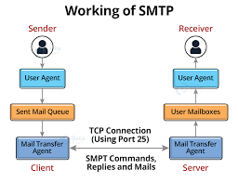
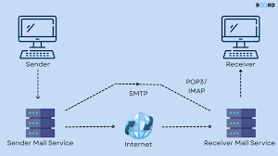
2024-25
Department : IT
S.Y - SEM – III DIV :B
Subject :CN Application Layer Protocol
TAE-II : Poster Presentation
The Application Layer is the topmost layer in the Open System Interconnection (OSI) model. This layer provides several ways for manipulating the data which enables any type of user to access the network with ease. The Application Layer interface directly interacts with the application and provides common web application services. The application layer performs several kinds of functions that are required in any kind of application or communication process. In this article, we will discuss various application layer protocols.
HTTP (Hypertext Transfer Protocol) HTTP stands for Hypertext Transfer Protocol and HTTPS is the more secured version of HTTP, that’s why HTTPS stands for Hypertext Transfer Protocol Secure. This protocol is used to access data from the World Wide Web. HTTP is based on the client-server model. It uses TCP for establishing connections. HTTP is a stateless protocol, which means the server doesn’t maintain any information about the previous request from the client. HTTP uses port number 80 for establishing the connection. | DNS (Domain Name System) DNS, or Domain Name System, is a hierarchical and decentralized naming system used to translate human-readable domain names (like www.example.com) into machine-readable IP addresses (like 192.0.2.1). This translation is crucial because while humans prefer to use names, computers communicate using numeric addresses. It is primarily used in networks of interconnected mainframes. Port number for X window starts from 6000 and increases by 1 for each server. | FTP (File Transfer Protocol) FTP stands for File Transfer Protocol. It is the protocol that actually lets us transfer files. It can facilitate this between any two machines using it. But FTP is not just a protocol but it is also a program. FTP promotes sharing of files via remote computers with reliable and efficient data transfer. The Port number for FTP is 20 for data and 21 for control.
SMTP (Simple Mail Transfer Protocol) Simple Mail Transfer mechanism (SMTP) is a mechanism for exchanging email messages between servers. It is an essential component of the email communication process and operates at the application layer of the TCP/IP protocol stack. SMTP is a protocol for transmitting and receiving email messages. In this article, we are going to discuss every point about SMTP. SMTP Protocol: The sender’s user agent prepares the message and sends it to the MTA. The MTA’s responsibility is to transfer the mail across the network to the receiver’s MTA. To send mail, a system must have a client MTA, and to receive mail, a system must have a server MTA. The SMTP model is of two types: 1.End-to-End Method 2.Store-and-Forward Method
Advantages
Simplifies Analysis: Abstracts away constants and lower-order terms, focusing on growth rates.
Scalability Insight: Helps understand how algorithms perform with large inputs
Algorithm Comparison: Makes it easy to compare efficiency across algorithms.
Implementation Agnostic: Ignores hardware and implementation specifics
Example
O(n): A single loop running n times, such as traversing an array, has time complexity O(n).
Ω(1): Accessing an element in a hash table, in the best case, takes constant time, Ω(1).
Θ(n log n): Merge sort has both upper and lower bounds of n log n, making its time complexity Θ(n log n).
Navinkumar Tumma : (23)
Pratham Tannirwar : (40)
Prince Maurya : (44)
Guided By : Prof Yogesh Gite Sir

